Slide 1




CS523-BDT-Final Project on SOCCOR ANALYSER
Submitted By:
PUSKAR BUDHATHOKI,
MHRETEAB ADHANOM BERHE
NATNAEL BERHE
Submitted To: Prof. MRUDULA MUKADAM

Slide 2
Project Overview
Dataset: we have used International Football Results from 1872 to 2023 dataset from popular website Kaggle: (https://www.kaggle.com/datasets/martj42/international-football-results-from-1872-to-2017?datasetId=4305)
Spark: It is used for getting the dataset and performing some filter and aggregation
Hive/HBase: The enriched result is saved in Hive/HBase.
Kafka: Distributed messaging system which is used for streaming analytics and data integration(Demo Project)

Slide 3
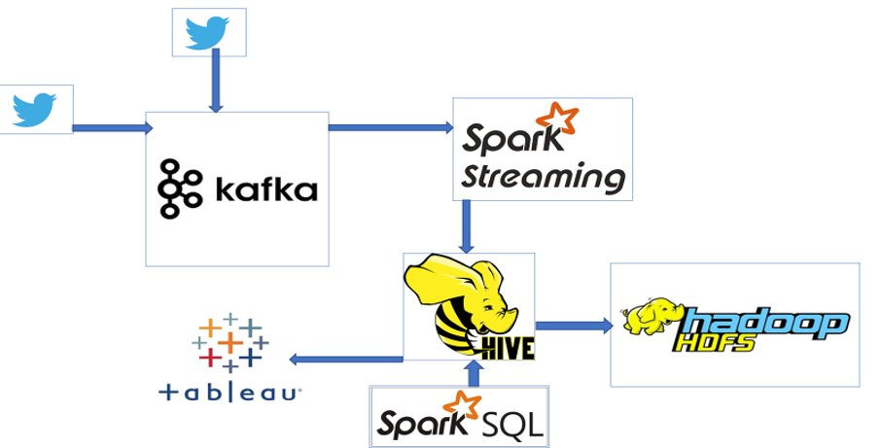

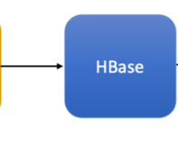
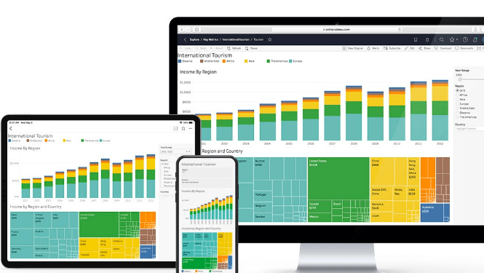
Project Overview
INPUT
DATA
Tableau

Slide 4
Technology stack used
Spark streaming – 2.4.4
Spark core – 2.4.4
Java - 8
Hadoop – 2.6.0
Hbase – 2.2.5
Hive – 2.3
Kafka – 2.13-3.5.1

Slide 5
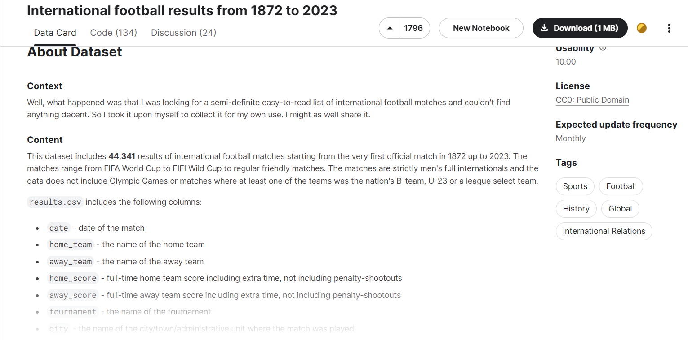
Dataset used
Used static football dataset from kaggle
https://www.kaggle.com/datasets/martj42/international-football-results-from-1872-to-2017?datasetId=4305
Created a program to split the whole dataset into smaller datset to use apache data streaming

Slide 6
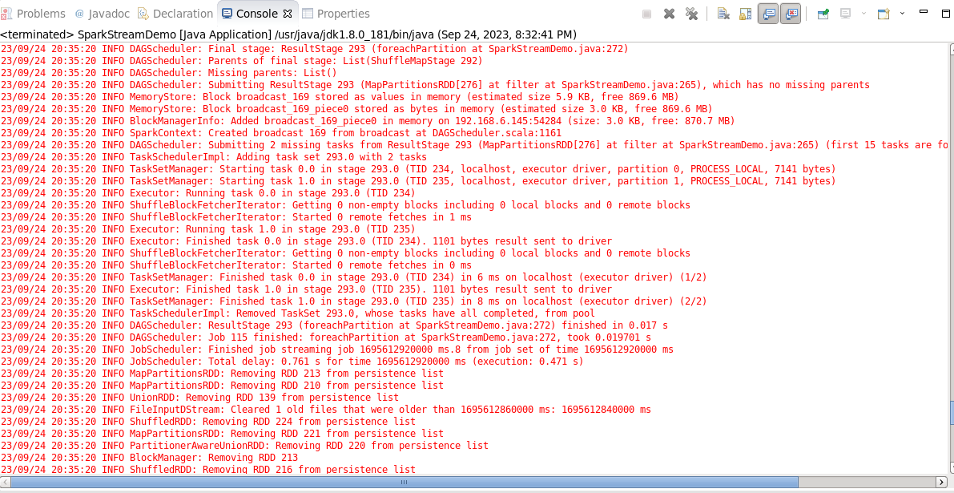
Apache Data Streaming sample
Received csv file as text stream input and allocate infrastructure to complete the allocated jobs
Fig 2: Apache data stream console

Slide 7

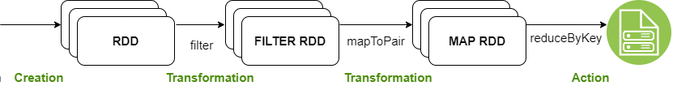
Spark Streaming
Get international football statistics from the split dataset
Filter required columns like home_team, away_team, home_goal, away_goal, city, match_type etc
Calculate total scores by each country, frequency of match type, organizing city with frequency
Filter data based on threshold values for different use cases
Text Stream

Slide 8

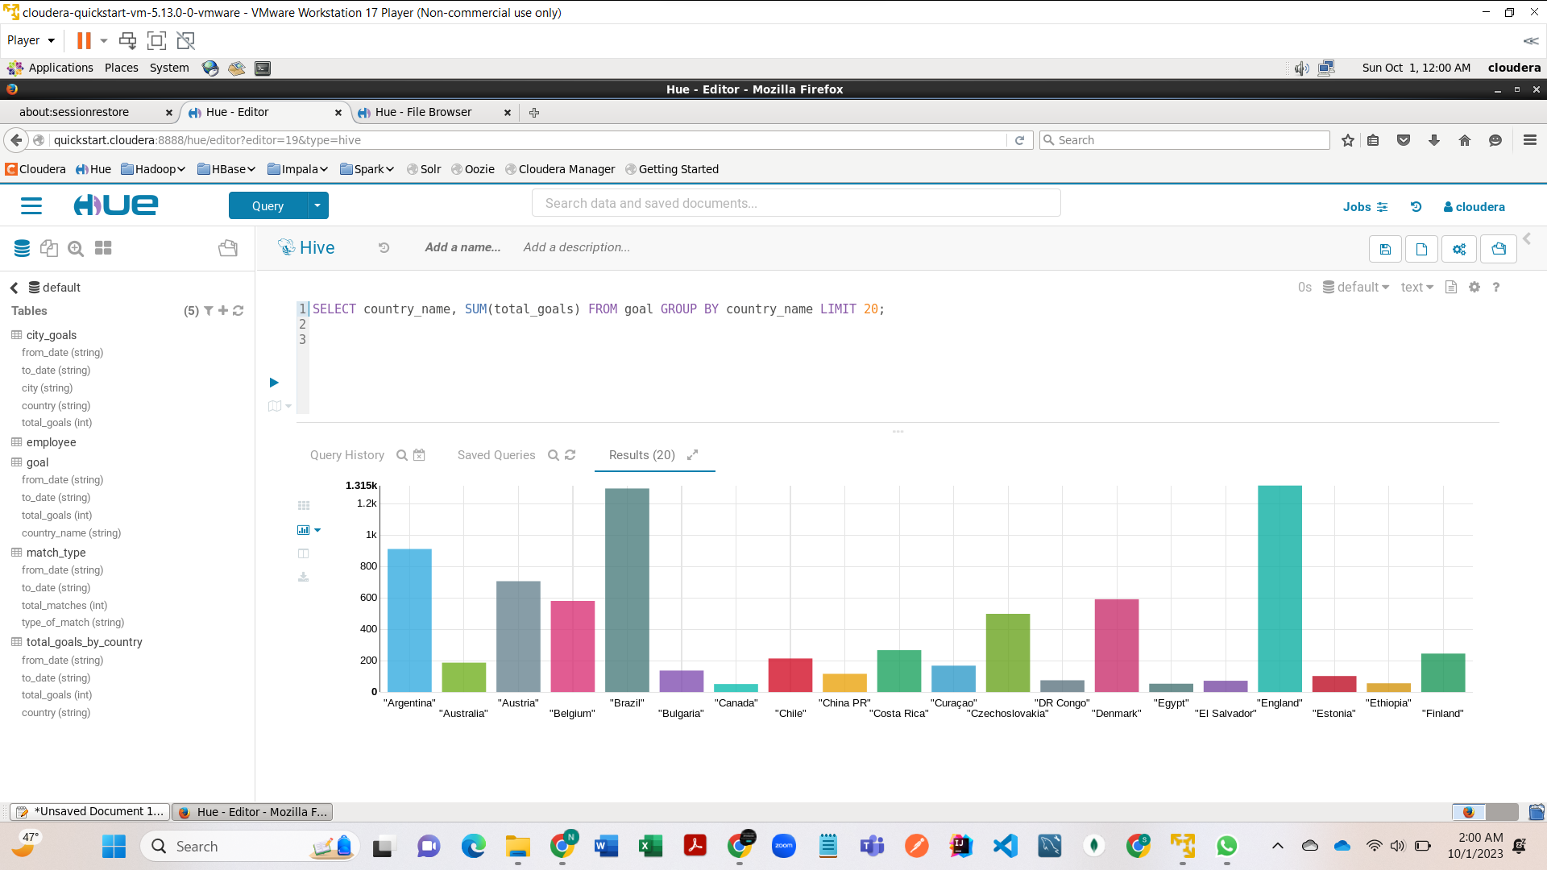
Apache HBASE/Hive
The output data from spark (aggregated) is persist in HBase/Hive database

Slide 9

Project execution steps
Step 1(Data preparation):
01
Created a account in kaggle (https://www.kaggle.com/)
Downloaded static dataset related to international football
split the dataset into smaller files so that we can apply data streaming and processing operations
Step 2(Data feed to Apache Spark Data Streaming ):
02
The pipeline is written in shell script which fetch data from local directory in Cloudera VM to the Apache Data Streaming in certain interval of time
Step 3(Real-time Analysis with Apache Spark Streaming):
Ingest data in every 20 seconds.
Text file streaming is used to load data.
Different stream function like filter, maptoPair, Union, reducebykey etc are used.
complex data structure with multiple Tuple are used to get the aggregate data from input data.

Slide 10
Project execution steps
Step 4(Data Processing with Apache Hive):
Schema Definition: Defined a Hive schema that matches the structure of the output result from Apache data streaming
Data Loading: Load the CSV data into a Hive table using Hive's LOAD DATA command or other methods for bulk data loading.
Data Transformation: Use Hive's SQL-like language, HiveQL, to perform various data transformations and aggregations. we calculated statistics, filter data by date, tournament, or teams, and perform other necessary preprocessing.
Querying: We ran Hive queries to extract insights from the data. For example, we found the countries with the most international goals, city and country organizing most games, the pattern of football match in international tournament, and more.

Slide 11
Project execution steps
Step 5(Data Export to HBase):
For the demonstration, the aggregate soccer result is exported in HBase table SoccorScoreTable. Every aggregated result from RDD partitions are saved to HBase column-family for use case1 soccer result.

Slide 12

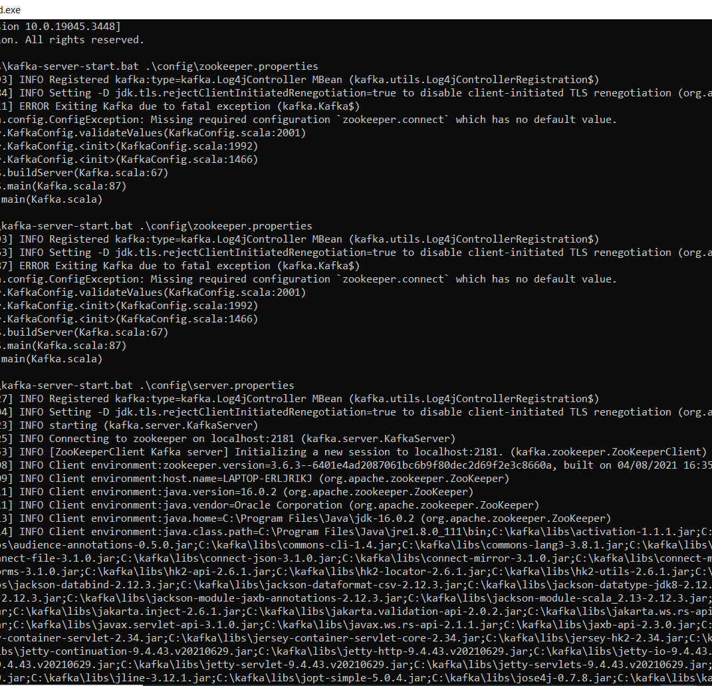


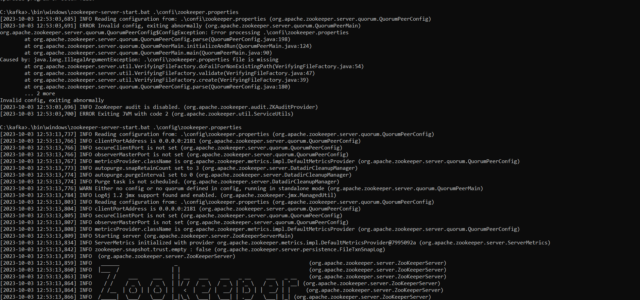
Apache Kafka
Consist brokers (Kafka cluster) and manage by zookeeper

Slide 13
Kafka Demo steps (Demo project related)
CMD to start zookeeper
.\bin\windows\zookeeper-server-start.bat .\config\zookeeper.properties.
CMD to start Kafka
.\bin\windows\kafka-server-start.bat .\config\server.properties
. CMD to create a topic
./bin/kafka-console-consumer.sh --bootstrap-server localhost:9092 --topic gameStriming_Topic [--from-beginning]
. CMD to create a producer
./bin/kafka-console-producer.sh --broker-list localhost:9092 --topic quickstart-events

Slide 14
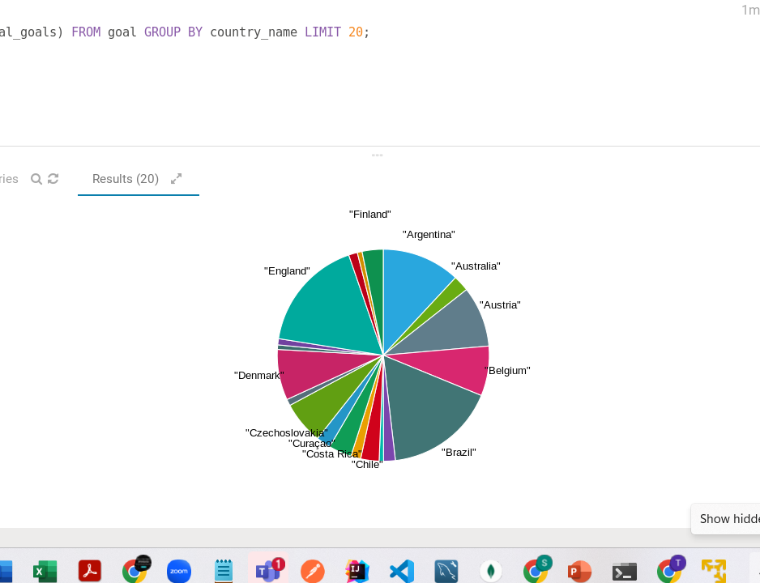
Future tasks
Output and Visualization:
We planned to do visualization of some statistics.
In future, We plan to visualize the real-time data and insights using data visualization tools like Apache Zeppelin, Jupyter Notebook, or Tableau(connect with Cloudera Hadoop using ODBC client and fetching data from the Hive Tables)​.
This can help us provide live updates to football enthusiasts.

Slide 15


